Slide 1
2023 Capstone Presentation
INFM480
Dr. Liu
Tyler Berry, December 14, 2023

Slide 2
Background
According to the Pew Research Center (Faverio, M.), 75% of U.S. adults who say they use the internet are 65 and over.
According to a study done by the Nielsen Norman Group (Kane, L.) small font sizes and unforgiving interfaces are two challenges internet user in this age range face.
According to the World Wide Web Consortium (W3C) vision and cognitive ability are two age-related impairments that can affect how elderly users use the internet.

Slide 3
Purpose of Study
The purpose of this study is to find common challenges to elderly (65 and over) internet users
Using the Kroger, to develop a “Senior friendly” mode
This mode will be used to help with the common challenges that elderly internet users may face when using the internet
For this project, the challenge of vision and cognitive ability.

Slide 4
Project Deliverable
The final deliverable will be to develop a prototype of the “Senior friendly” mode function
The prototype will be based on the Kroger website
All tasks given on tasks list will be able to be completed on prototype

Slide 5
Success Measurements
To create a senior friendly prototype of Kroger website
Key functions will be able to be 100% completed on prototype
Functions will be done via task list

Slide 6
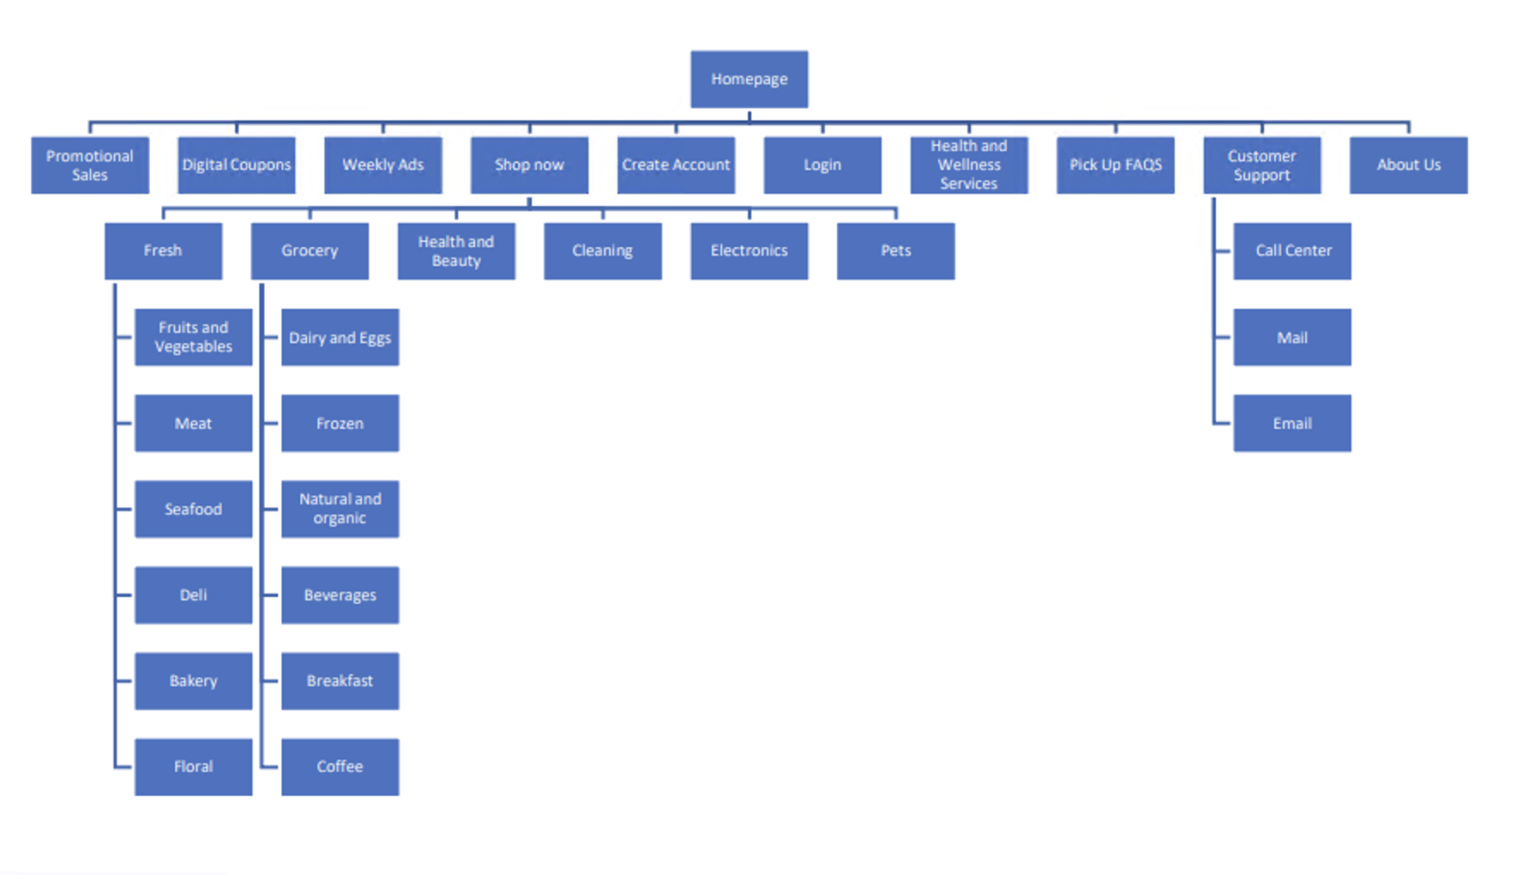
Site Structure

Slide 7
Storyboard

Slide 8
Storyboard

Slide 9
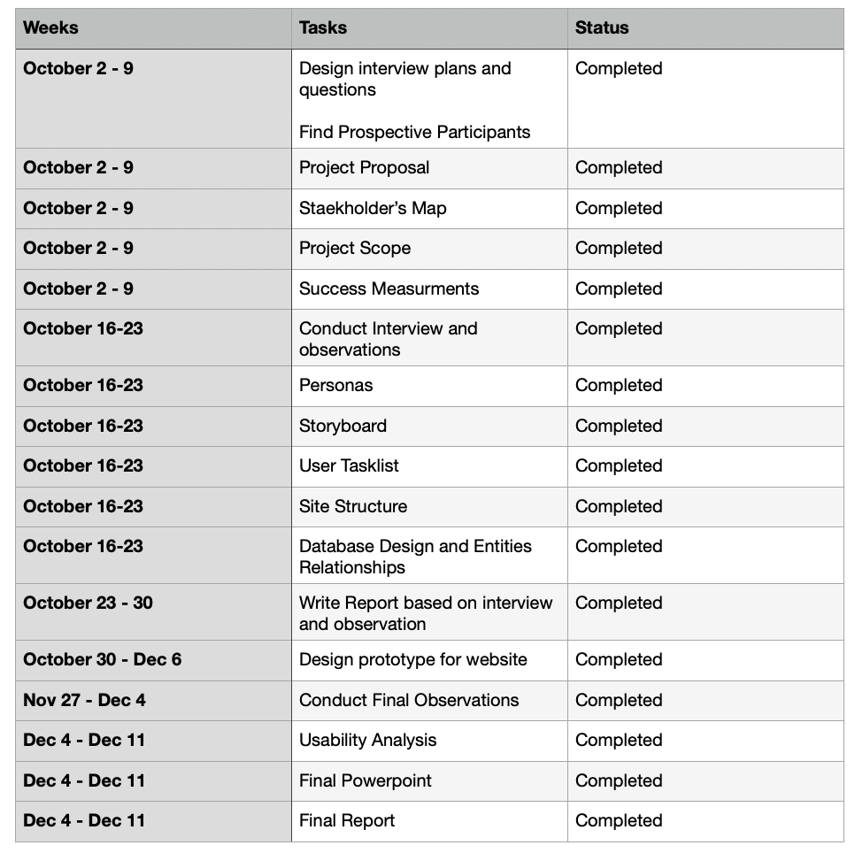
Project Timeline

Slide 10
Tasklist
1) Enable Senior mode (For prototype observation)
2) Find link to customer support
3) Find Create account
4) Find weekly ads
5) Using filter function, find dairy and egg products that are on sale
6) Find link to digital coupons
7) Find about us link
8) Find Kroger promotion sales
9) Find pickup FAQS
10) Find information about health and wellness services

Slide 11
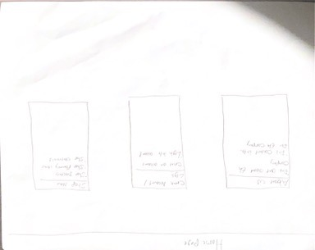
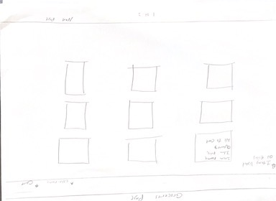
Prototype (Version 1)

Slide 12
Prototype (Version 1)
A handwritten prototype
Tiled layout
Demonstrates some of the basic functions for later versions of the prototype

Slide 13
Prototype (Version 2)

Slide 14
Prototype (Version 2)
A digital version of the handwritten prototype
Features Kroger logo and blue banner
Basic functions of prototype featured

Slide 15
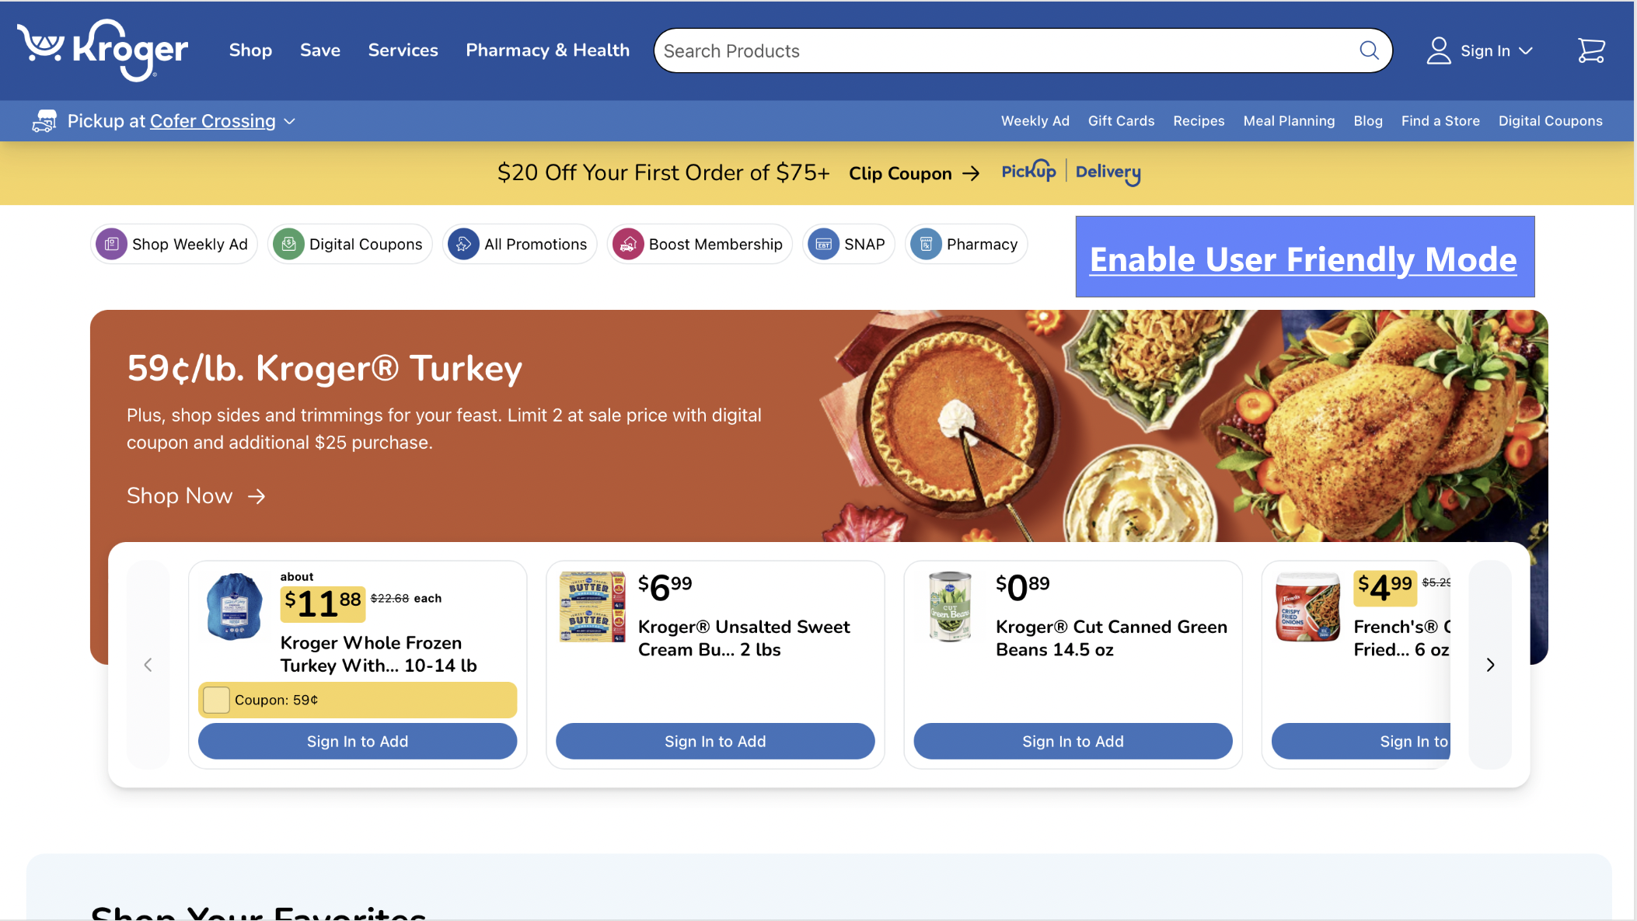
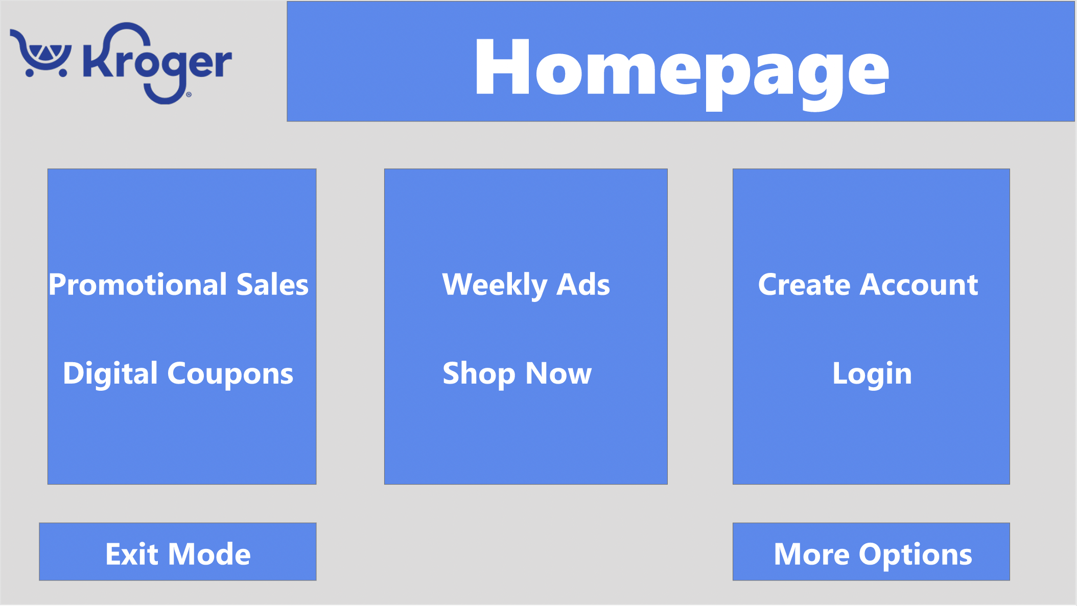
Prototype (Version 3)

Slide 16
Prototype (Version 3)
Senior mode featured on the main Kroger webpage
Exit mode and more options presented at the bottom of the pages
More feature (shop now and about us) were included in the prototype

Slide 17
Prototype (Version 4)

Slide 18
Prototype (Version 4)
Color changes to match the official Kroger logo color
Pictures added to the various function, such as food on the groceries tiles added

Slide 19
Prototype (Version 5)

Slide 20
Prototype (Version 5)
Exit mode changed to Exit Senior Mode for better specificity
Text for Pick Up FAQs and About Us pages was made larger
Tiles added to display the price of products added

Slide 21
Social Impact
To improve user experience for elderly internet users
To integrate the senior friendly function for commercial websites, so that interfaces would be easier for these users
To make a call to developers for the implementation of functions that would help enhance elderly user experiences in the world of technology at large

Slide 22
References
Faverio, M. (2022, January 13). Share of those 65 and older who are tech users has grown in the past decade. Pew Research Center. https://www.pewresearch.org/short-reads/2022/01/13/share-of-those-65-and-older-who-are-tech-users-has-grown-in-the-past-decade/
Kane, L. (2019, September 8). Usability for seniors: Challenges and changes. Nielsen Norman Group. https://www.nngroup.com/articles/usability-for-senior-citizens/
Petrosyan, A. (2023, August 30). Internet usage by age in U.S. 2021. Statista. https://www.statista.com/statistics/266587/percentage-of-internet-users-by-age-groups-in-the-us/#:~:text=U.S.%20internet%20usage%20penetration%202021%2C%20by%20age%20group&text=A%20further%20share%20of%2075,96%20percent%20were%20internet%20users.
Henry, S. L. (Ed.). (2020, August 14). Older users and web accessibility: Meeting the needs of Ageing Web Users. Web Accessibility Initiative (WAI). https://www.w3.org/WAI/older-users/

